Slide 1

Sprint 2 Presentation

Slide 2
What we did this sprint
iOS app
Android app
Desktop app

Slide 3
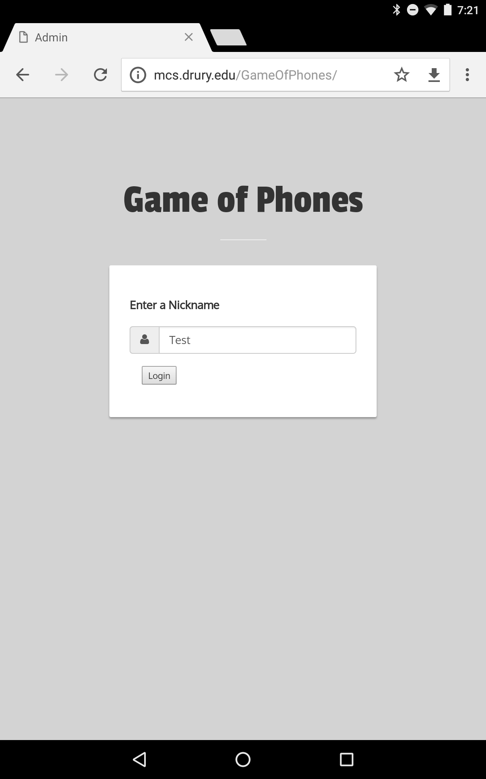
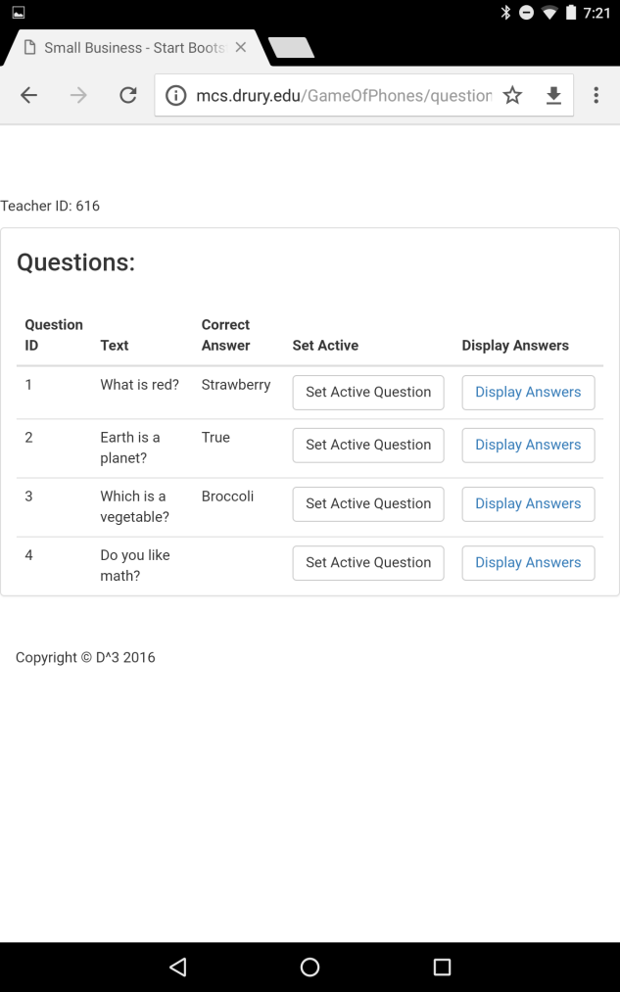
System walkthrough
Teacher registers and selects a current question

Slide 4
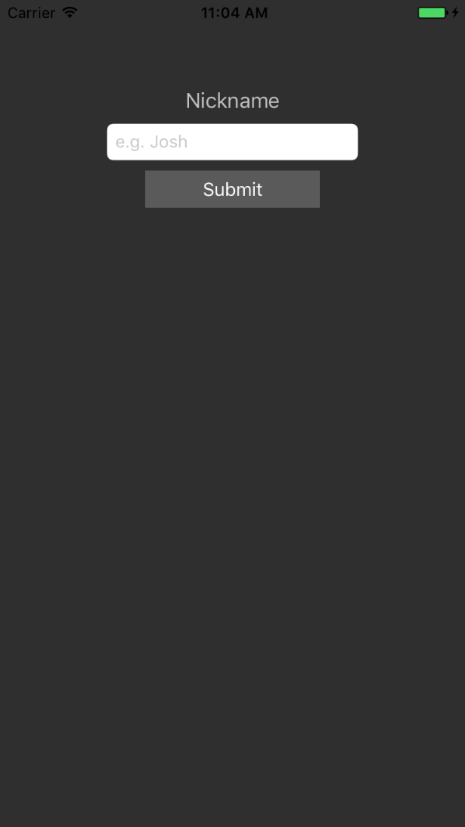
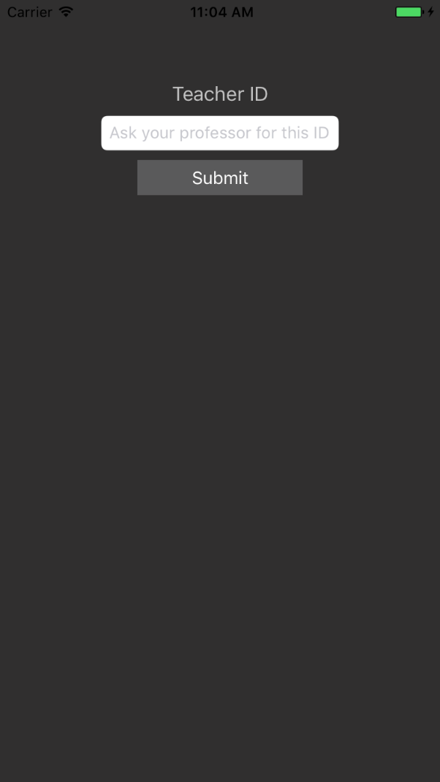
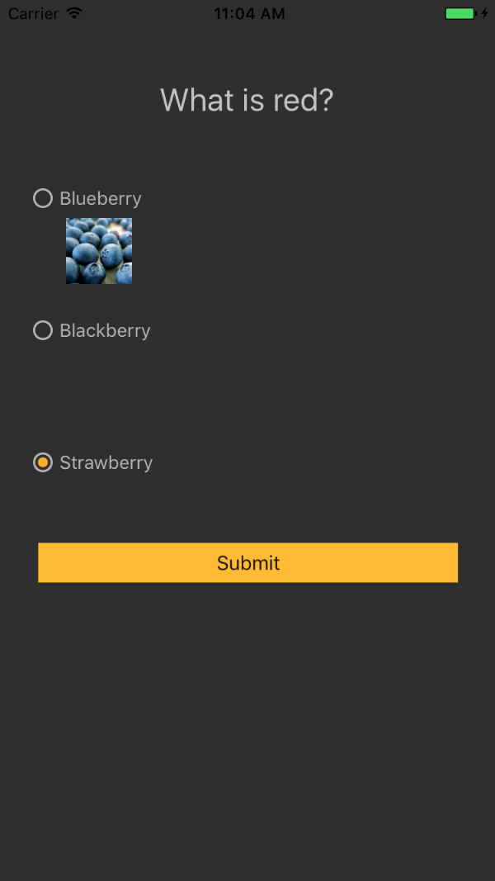
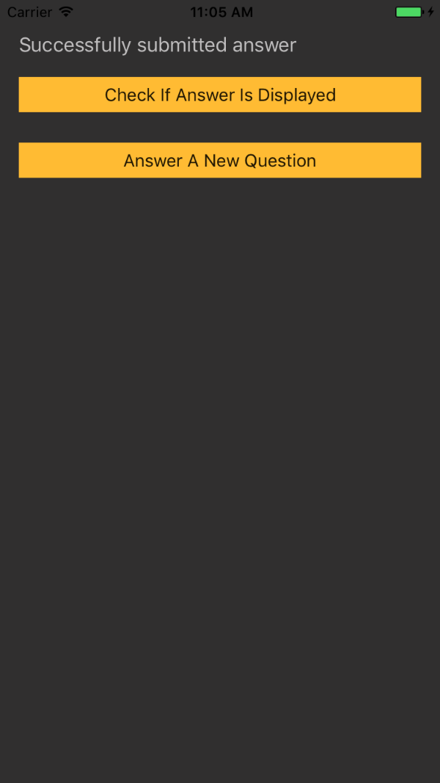
Student registers and inputs teacher ID. Views the question and submits an answer.

Slide 5
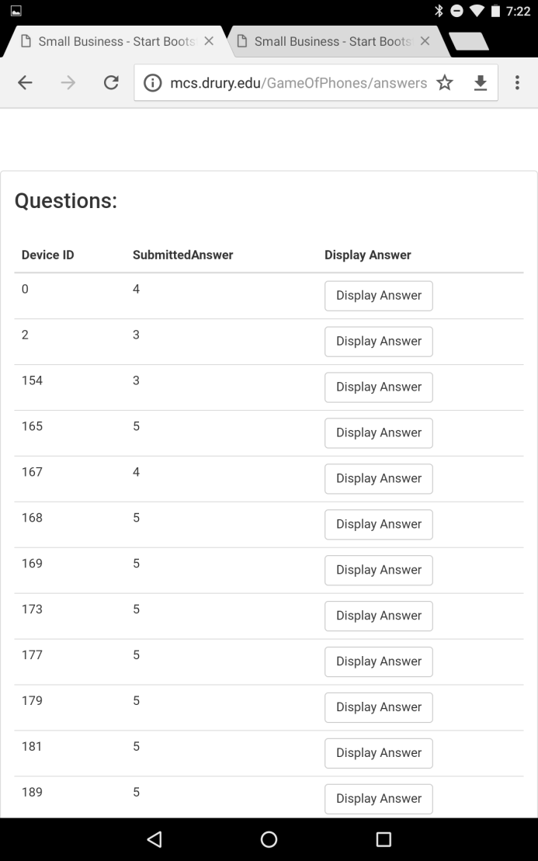
Teacher sees all submitted answers and picks which ones to display.

Slide 6
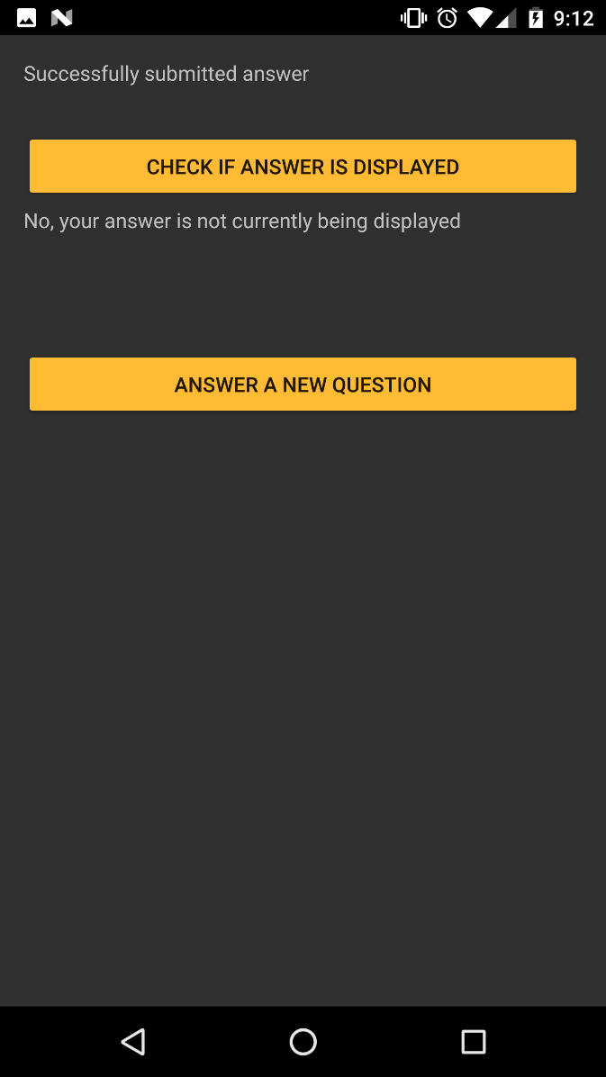
Students can see whether or not their answer was chosen to display.

Slide 7
Acceptance?
Display Current Question
Selected question is displayed on desktop application
Selected Displayed Answers
Desktop app can display selected answers
See if Answer is Chosen
A student can check if their answer was chosen to be displayed
Tests
Choose a question and make sure it is being displayed on the desktop
Select answers to be displayed and make sure they are being displayed
Select an answer to be displayed and make sure the student can check if it was their answer.

Slide 8
Sprint 3 Inception Plans, Specifically
To-do:
Use case diagram (actors, case descriptions) (3/6) Kyle and Josh
Research technology for drawing and submitting images from a phone (3/8) Amelia
Effort estimate (3/8) Zach

Slide 9
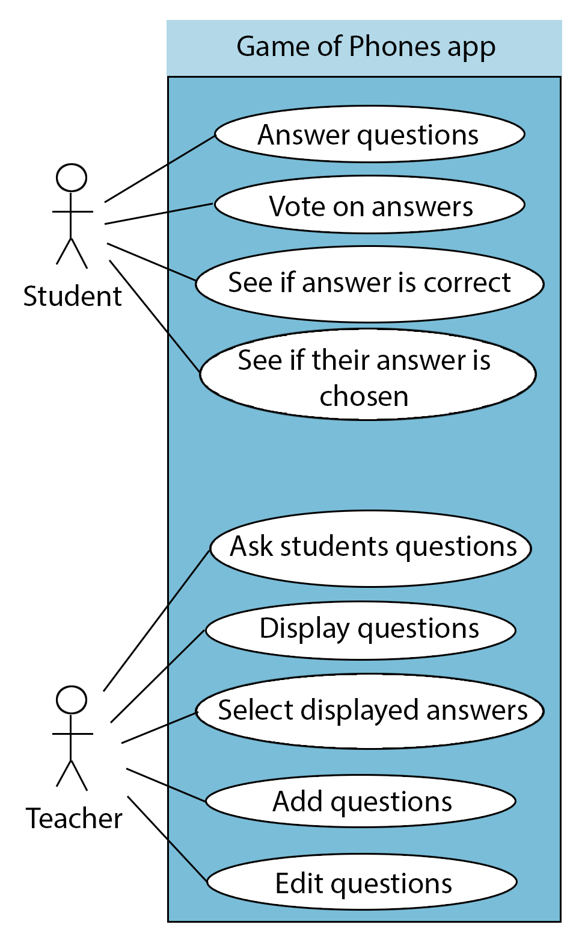
Sprint 3 Plans
High Priority:
Add and edit questions (desktop)
Graph functionality (mobile)
Low Priority:
Voting system for students
Clear unneeded data from database
Display whether or not answer is correct

